Slide 1
CAPSTONE PROJECT 2
QUARA INSINCERE QUESTIONS CLASSIFICATION

Slide 2
PROBLEM
An existential problem for any major website today is how to handle toxic and divisive content.

Slide 3
CLIENTS
Quora is a platform that empowers people to learn from each other.
On Quora, people can ask questions and connect with others who contribute unique insights and quality answers.
By using sentiment analysis, platforms like Quora, they can develop more scalable methods to detect toxic and misleading content to improve online conversations.

Slide 4
DATA
The training set readily available on Kaggle.
In this project, we will be predicting whether a question asked on Quora is sincere or not.
An insincere question is defined as a question intended to make a statement rather than look for helpful answers.
The training data has 1,306,122 rows and 3 columns which are qid, question_text, and target.

Slide 5
DATA COUNTINUED
Some characteristics that can signify that a question is insincere:
Has a non-neutral tone *Has an exaggerated tone to underscore a point about a group of people *Is rhetorical and meant to imply a statement about a group of people
Is disparaging or inflammatory
Uses sexual content (incest, bestiality, pedophilia) for shock value, and not to seek genuine answers
The training data includes the question that was asked, and whether it was identified as insincere (target = 1).

Slide 6
DATA WRANGLING
Datas don't have NaN values and '', datas don't need to be cleaned.

Slide 7
EDA
During exploratory data analysis, we ask the following questions to understand more about our data:
How to handle unequal portiation of sincere and insincere questions?
How to drop the number of text from 1,306,122 to 1,000?
Word frequency?
Usually how many tokens are there in a question?
and ask follow-up questions if needed.

Slide 8
EDA CONTINUED
Numbers of sincere questions: 1225312
Numbers of insincere questions: 80810
Proportion very unbalanced, we have to try to scale datas. We will pick 5000 random sincere and 5000 insincere questions from the dataset.

Slide 9
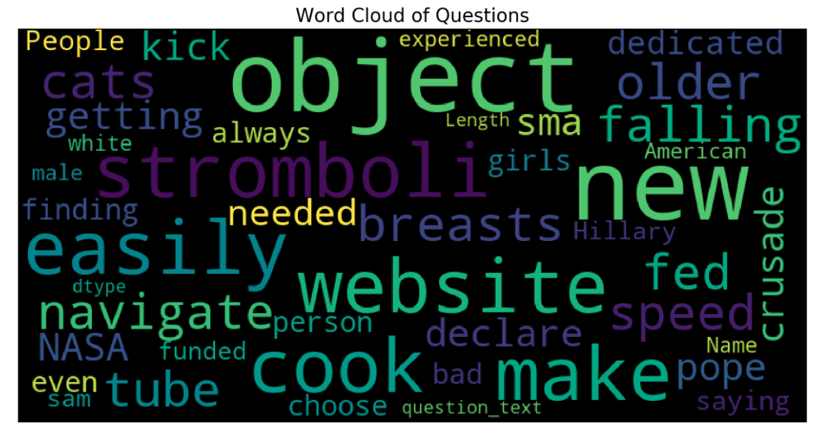
EDA CONTINUED
Notes:
There seem to be a variety of words in there. Maybe it is a good idea to look at the most frequent words in each of the classes separately.

Slide 10
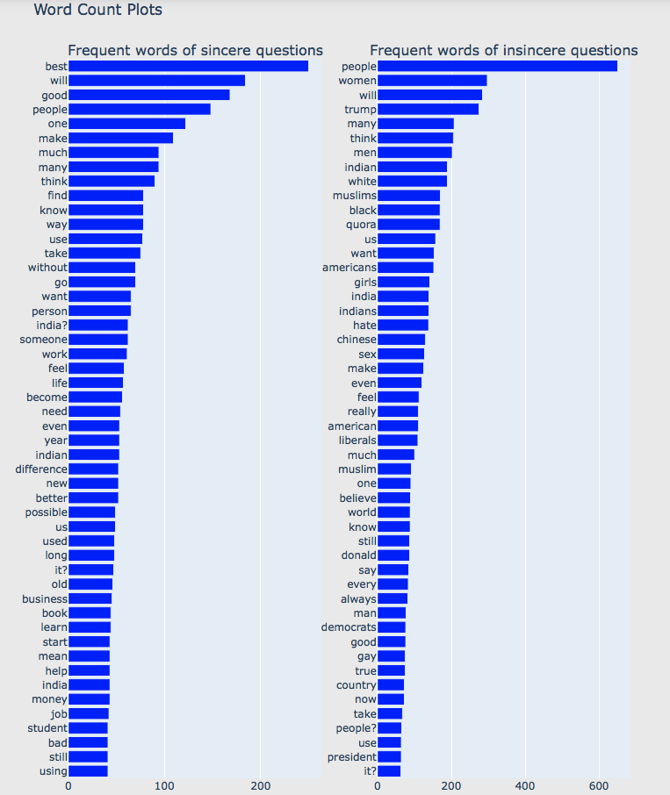

Slide 11
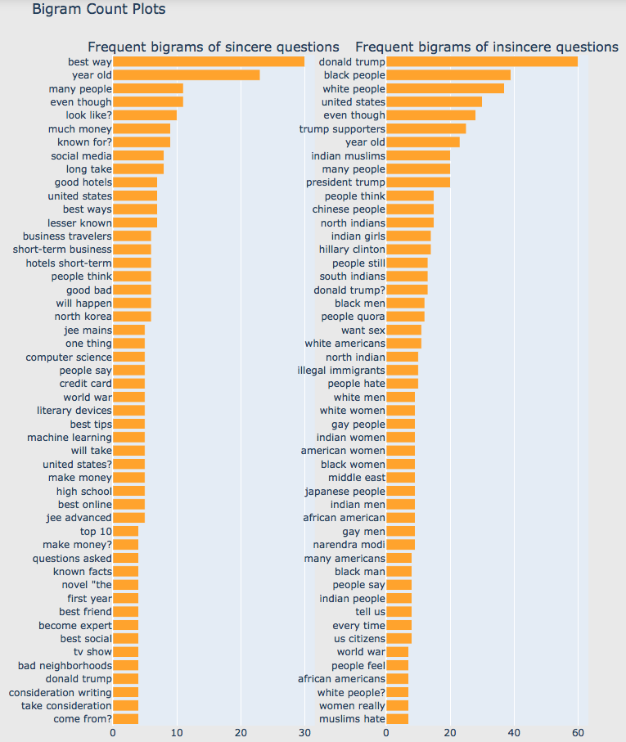

Slide 12
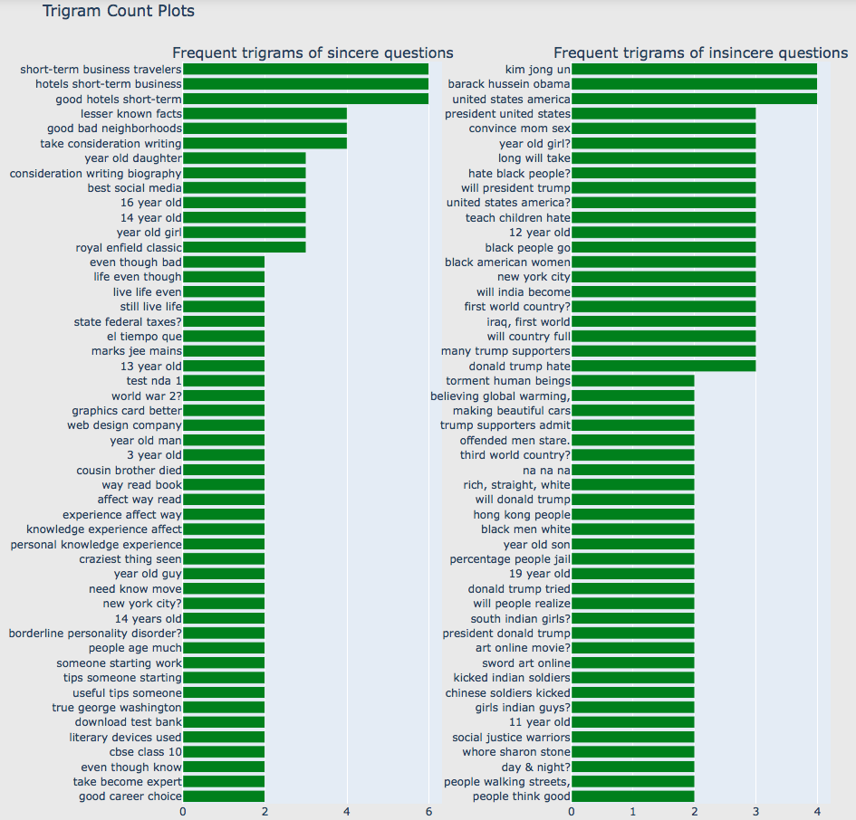

Slide 13
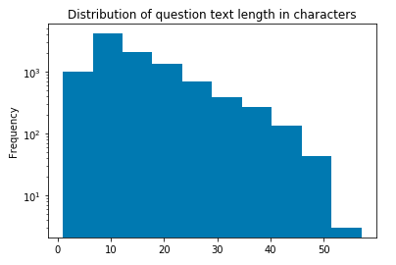
We also analyze the length of a question. After removing unwanted tokens, stop words & applying lemmatization, most of the questions have about 7 ~ 17 words long.

Slide 14
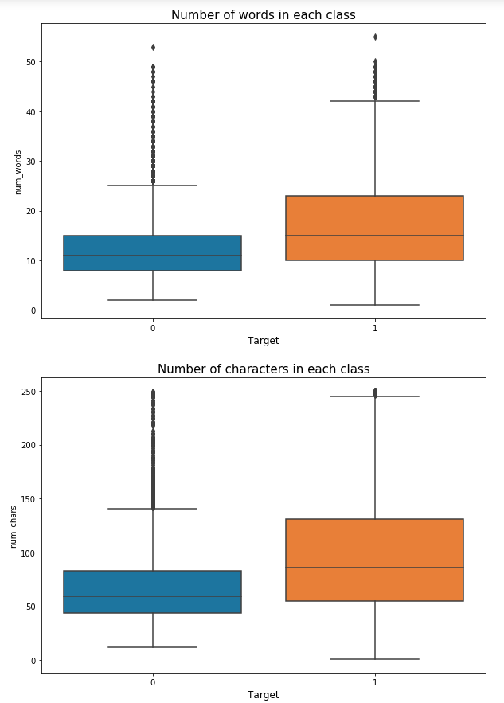
We can see that the insincere questions have more number of words as well as characters compared to sincere questions.
So this might be a useful feature in our model.

Slide 15
MODELING
With insights based on exploratory data analysis (EDA), we start to train predictive models.
As for modeling, we identified four Machine Learning models which are
Logistic Regression
Decision Tree
Random Forest
Gradient Boosting

Slide 16
CONCLUSION
In general Logistic regression has the best accuracy for prediction.
Training accuracy is always higher than test accuracy, which can be improved with more data.

Slide 17
NEXT STEPS
Apply dimmensionality reduction on texts to see if accuracies can be further improved.
Apply pre-trained model for embedding.
Using more data to improve test accuracies.

